Slide 1
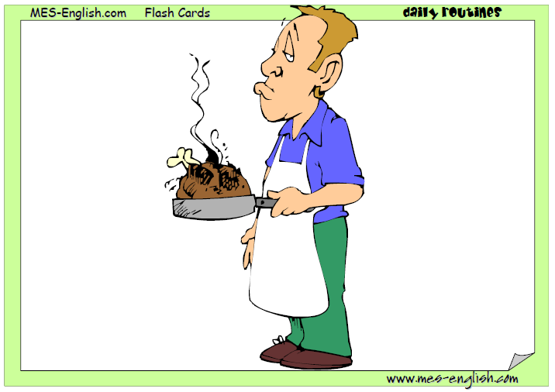
cooking

Slide 2
cooking

Slide 3
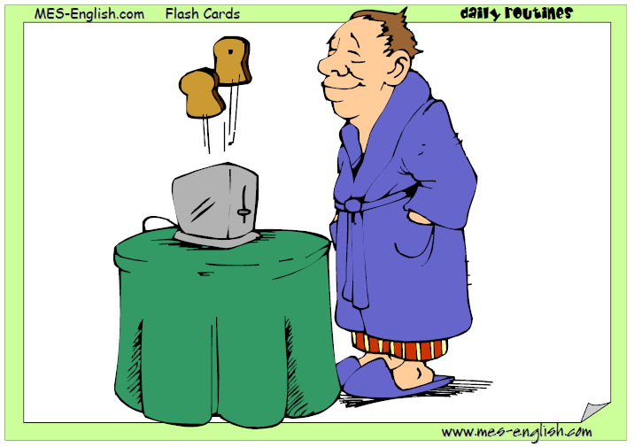
eating breakfast
having breakfast

Slide 4
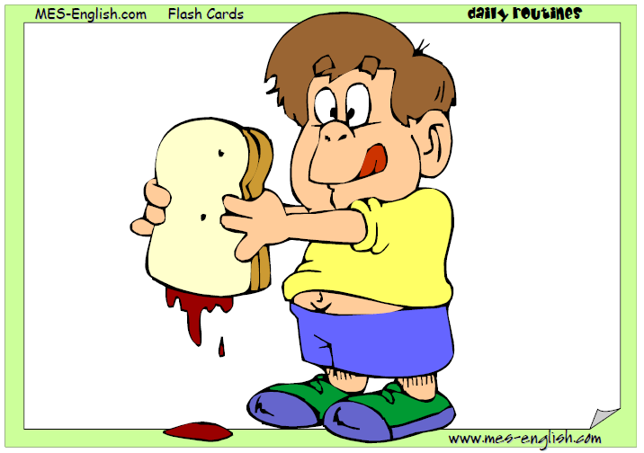
eating lunch
having lunch

Slide 5
having dinner
eating dinner

Slide 6
drinking

Slide 7
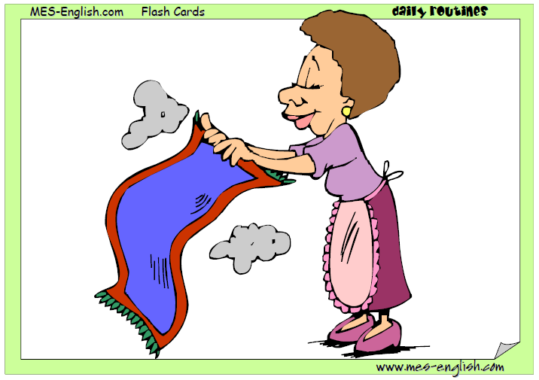
cleaning

Slide 8
walking

Slide 9
doing homework

Slide 10
reading

Slide 11
writing

Slide 12
studying

Slide 13
cleaning

Slide 14
drawing

Slide 15
playing the piano

Slide 16
watching TV

Slide 17
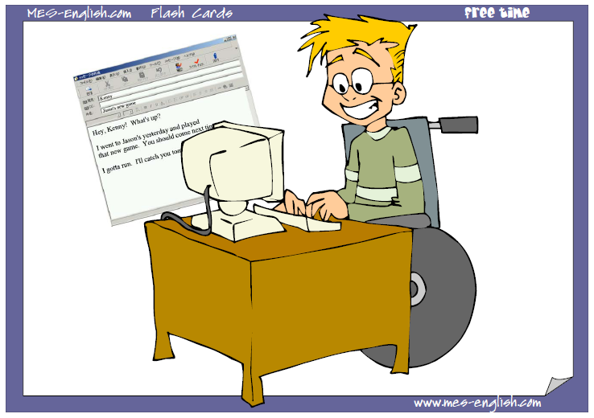
emailing friends

Slide 18
singing

Slide 19
dancing

Slide 20
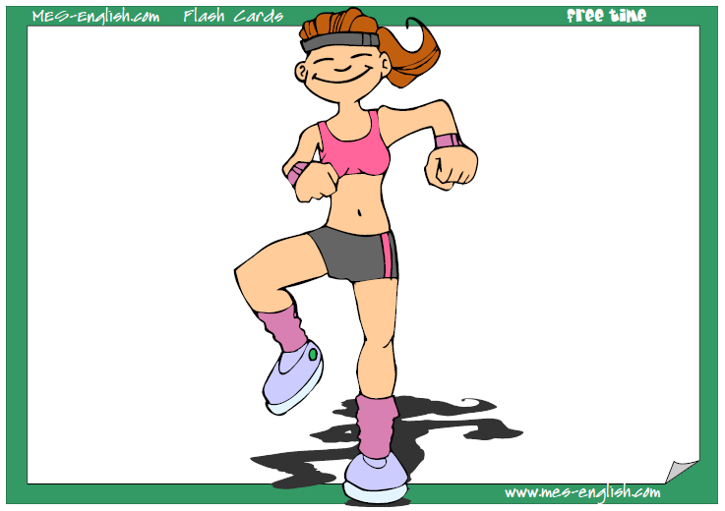
exercising

Slide 21
sleeping

